Slide 1


Ruth ten Hove
CSP Assistant Director, Chartered Society of Physiotherapy
Notes:
The purpose of the session is to share with you the work of the Community Rehab Alliance and then introduce you to the Community Rehabilitation Best Practise Standards.
But first, let’s set the scene.

Slide 2

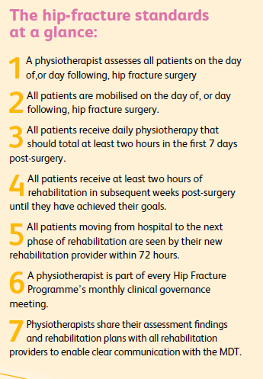
HipSprint
Outcomes
Early mobilisation
Intensive rehabilitation
Continuity of care
Local governance and
quality Improvement
Notes:
Focus for the presentation will be on the first three standards.
The standards have been mapped to key NICE standards and are reflective of NICE Hip fracture and intermediate care.
The first standard refers to assessment and is critical that this is undertaken by a physiotherapist –
As well as focus on physical abilities, which includes pre-hip fracture status (mobility in and outside), PT assesses cognitive ability and engagement in rehab. The assessment kick starts the tailored rehab programme, focused on returning the individual to pre-fracture status
A registered physiotherapist must perform the assessment.
The first assessment may occur either before or after the operation.
The NHFD data processor is able to identify the specific assessment of the physiotherapist for the purposes of NHFD data entry.
A clear and consistent method for recording the initial physiotherapist assessment is in place.
The physiotherapist assessment is shared with the MDT to facilitate clear communication and efficient care-planning
A physiotherapist may undertake the delirium assessment using the 4AT screening tool, for tariff payments, if they are part of the admission team.
A physiotherapist may undertake the multifactorial fracture prevention assessment (falls and bone health), for tariff payment.
Evidence:
A significant number of patients recovering from hip fracture experience poorly controlled pain, delirium and hypotension. Many patients experience dementia. These associated conditions require careful real-time clinical management according to individual patient needs. They are not absolute contraindications to mobilisation on the first day after hip fracture surgery yet they are commonly reported to unnecessarily delay mobilisation for a significant number of patients.

Slide 3

Working in partnership

Slide 4

The challenges we face

Slide 5

Our ambitions

Slide 6
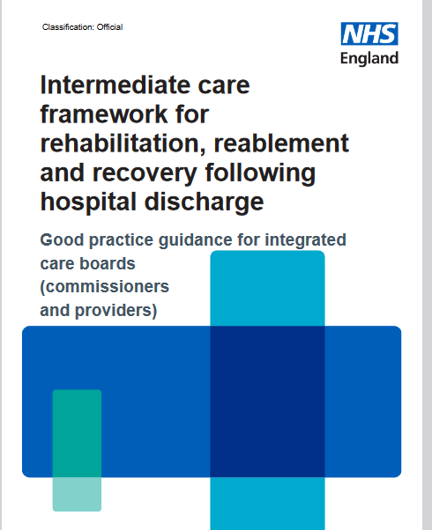

Slide 7
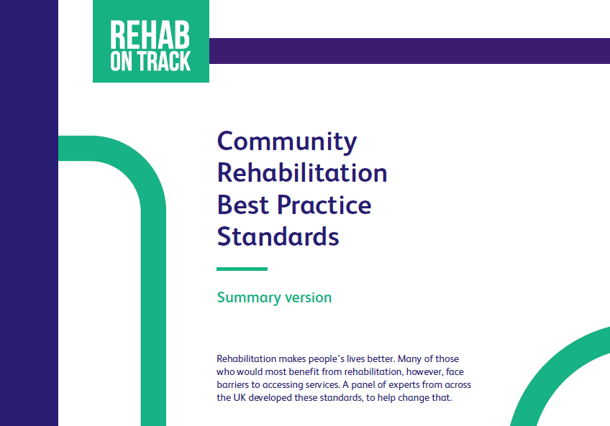



Slide 8



Key recommendations
for the system
1. Appoint a rehabilitation director/leader at executive level
2. Establish a local provider rehabilitation network to include all key players
3. Review existing rehabilitation services to remove silos of care and duplication of services
4. Publish an annual report on rehabilitation

Slide 9

Summary of the standards
1. Referral processes are explicit, easy, efficient and equitable
2. Rehab interventions should be, timely, co-ordinated and prevent avoidable disability.
3. Rehab pathways should address all rehab needs, be delivered locally and in appropriate formats.

Slide 10

Summary of the standards
4. Rehab pathways should be delivered locally with access to specialist services
5. Rehab should enable the individual to reach their optimal recovery and build their confidence to self manage.
6. Rehab service should be well led, adequately staffed and supported by a rehab network.
7. Rehab service should recognise the role and importance of families/carers and networks.
Notes:
Standard 4 - Rehabilitation pathways should meet needs and be delivered locally with access to specialist services
Key themes (a) needs led rehabilitation (b)integrated services (1⁰, 2⁰, 3⁰ health and social care, physical and mental health) (c) locality based care (d) access to equipment (e)access to specialists and specialist services.
Standard 5 - Rehabilitation programmes should enable optimisation, self-management and review
Key themes (a) optimisation of function (b)supported self management (c) regular review (d) long term conditions registers.
Standard 6 - Rehabilitation services are well led, adequately resourced and networked to other services
Key themes (a) audit, service evaluation and research (b) defining core data, (c) linking
Standard 7 – Rehabilitation services involve families

Slide 11


Who are the standards for?
To influence your system
To keep people out of expensive parts of the NHS
To slow the snowball effect of multiple conditions
To help ease pressure on the system
You
To improve patient experience, outcomes & satisfaction
To slow deterioration

Slide 12
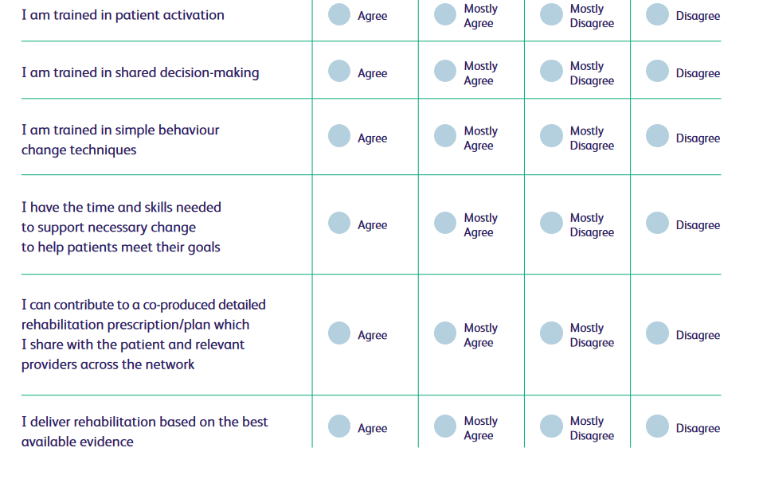
Use standards to engage in clinical audit

Slide 13



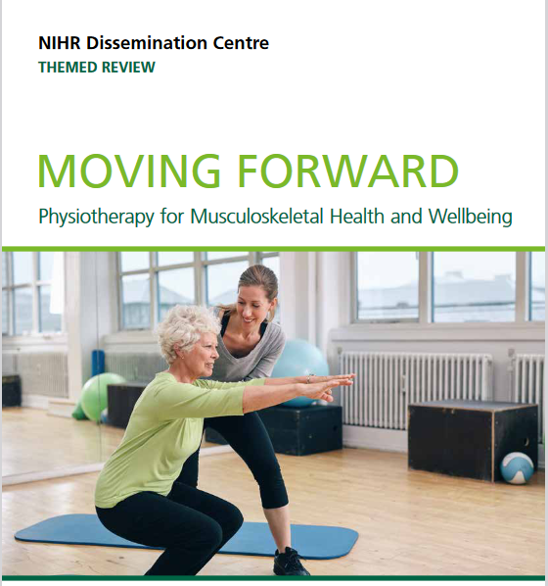
Adopting and adapting the evidence base

Slide 14
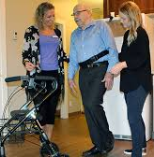
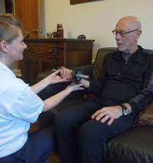
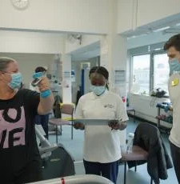
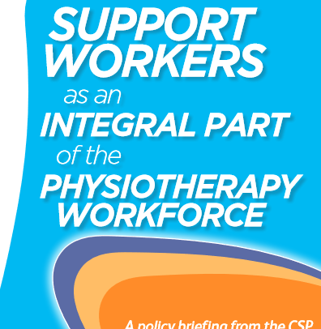
Use of the wider nonregistered workforce
Physiotherapy support workers provide interventions to support physiotherapy programmes and are an integral part of a multidisciplinary team.
They may undertake any delegated activity that is in pursuit of physiotherapy goals.
Professional supervision should be in place and access to support from a registered physiotherapist .

Slide 15

Innovation
Long waiting lists full of people with complex conditions. Consultations by rote. Signposting that wasn’t leading anywhere. The problems faced by a Sussex NHS physio practice were familiar ones.
That was until the team decided to change things. They booked out a local leisure centre and invited their entire waiting list for a Community Appointment Day, full of conversations, not consultations.
This venture achieved immediate results – with average waiting list times reduced by a third
https://www.newlocal.org.uk/articles/community-appointment-day/

Slide 16
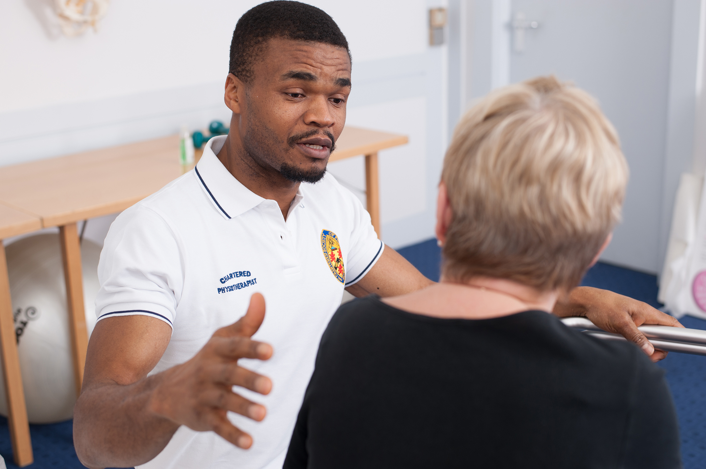

REHAB
ON TRACK
Community Rehabilitation Best Practice Standards
Thank you!
communityrehab@csp.org.uk
...

