Slide 1
Therapeutic exercise for common musculoskeletal conditions; flogging a dead horse?
Chris Littlewood PhD
Professor of Musculoskeletal Research

Slide 2
‘Over 20 million people in the UK (around a third of the population) live with a musculoskeletal (MSK) condition…’

Slide 3
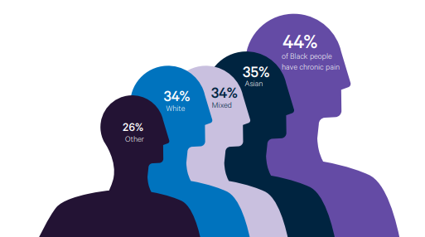
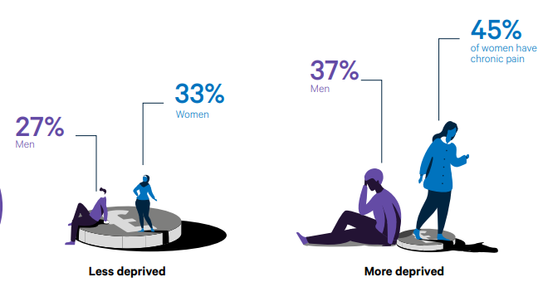
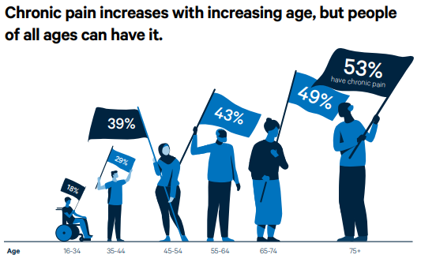

Slide 4
Effectiveness of current treatments is unremarkable

Slide 5
Tennis Elbow
Physiotherapy superior to CCS injection but not wait-and-see…

Slide 6
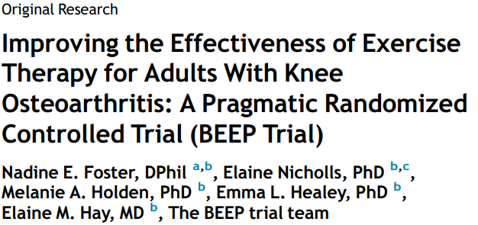
Knee pain – enhancing provision of therapeutic exercise
Usual physical therapy (up to 4 sessions of advice & exercise over 12 weeks)
Individually tailored exercise (individualized, supervised, and progressed lower limb exercises, 6-8 sessions over 12 weeks)
Targeted exercise adherence (transitioning from lower limb exercise to general physical activity, 8-10 contacts over 6 months)
There were no significant differences between groups at 6 months

Slide 7
Effectiveness of current treatments is unremarkable

Slide 8
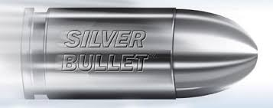
Why are the outcomes from these trials so unremarkable?

Slide 9
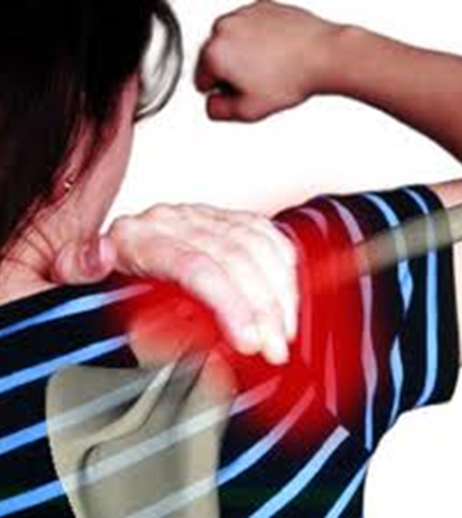
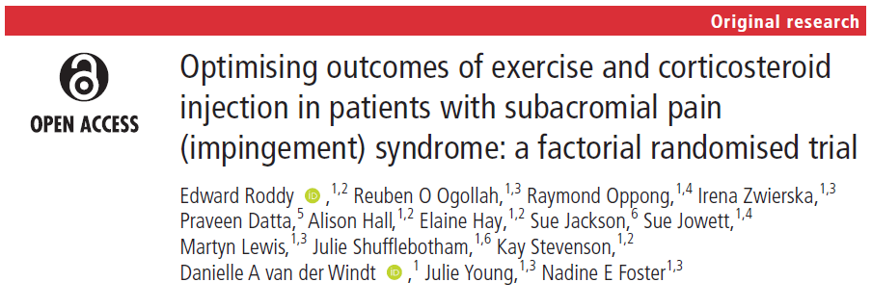
My shoulder hurts!
Mean age = 54 years
SPADI = 61 (severe)
25% overweight
46% obese/ morbidly obese
25% widespread pain
45% not in paid job
54% previous or current smokers

Slide 10
My ‘insert joint’ hurts!
‘…I don’t know how it started’
For many people the injury model does not explain the onset and persistence of symptoms
History lesson: Part one
In the 1990’s - tendinitis
In the noughties – tendinosis
Then- tendinopathy…

Slide 11
Why does my ‘insert joint’ hurt?
‘The existing evidence supports the hypothesis that increased numbers of inflammatory cells are present in pathological tendons.’
Mean age = 54 years
SPADI = 61 (severe)
25% overweight
46% obese/ morbidly obese
25% widespread pain
45% not in paid job
54% previous or current smokers

Slide 12
Smoking increases the expression of pro-inflammatory cytokines (IL-1, IL-6, TNFα)
54% previous or current smokers (Roddy et al. 2020)

Slide 13
‘Smoking, waist circumference and waist-to-hip ratio were related to an increased prevalence of shoulder pain…’
25% overweight / 46% obese/ morbidly obese (Roddy et al. 2020)

Slide 14
‘A consistent association between diabetes and shoulder disorders, some associations for weight-related factors aswell as a possible preventive effect from physical exercise and sports suggest a metabolic pathophysiological process in shoulder disorders.’

Slide 15
Does ‘therapeutic exercise’ target these factors?

Slide 16
Concluding thoughts…
Our current understanding of the ‘cause’ of pain only scratching the surface
How useful are our current ’diagnoses’ in 9/10 cases? Do they direct treatment? Do they improve clinical outcomes for patients?
How current treatments work, or don’t work, is poorly understood
Unremarkable outcomes from current treatments in clinical trials
Opportunity to think differently about this and other common MSK problems
Are our current treatments better than the passage of time?
If so (bigger if than you might expect), how can we optimize treatments, including ‘letting go’ of traditional physiotherapist-led treatments?

Slide 17
Therapeutic exercise for common musculoskeletal conditions; flogging a dead horse?

