Slide 1
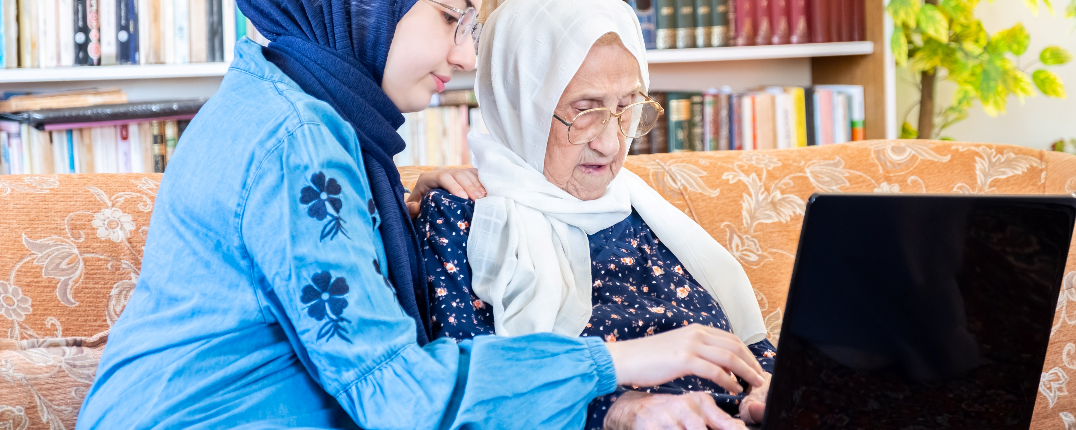
School of Medicine
Leeds Institute of Rheumatic and Musculoskeletal Medicine
How can we optimise pre-operative knee replacement education and prehabilitation? Lessons learned from developing a ‘Virtual Knee School’
Dr Anna Anderson, Research Fellow in Qualitative Research
Leeds Institute of Health Sciences

Slide 2
?

Slide 3
>97,600
total knee replacements (TKRs) recorded on the National Joint Registry in 2019 (NJR, 2021)

Slide 4
>97,600
total knee replacements (TKRs) recorded on the National Joint Registry in 2019 (NJR, 2021)
23% of patients awaiting TKR report a health state ‘worse than death’ (Clement et al. 2021)

Slide 5
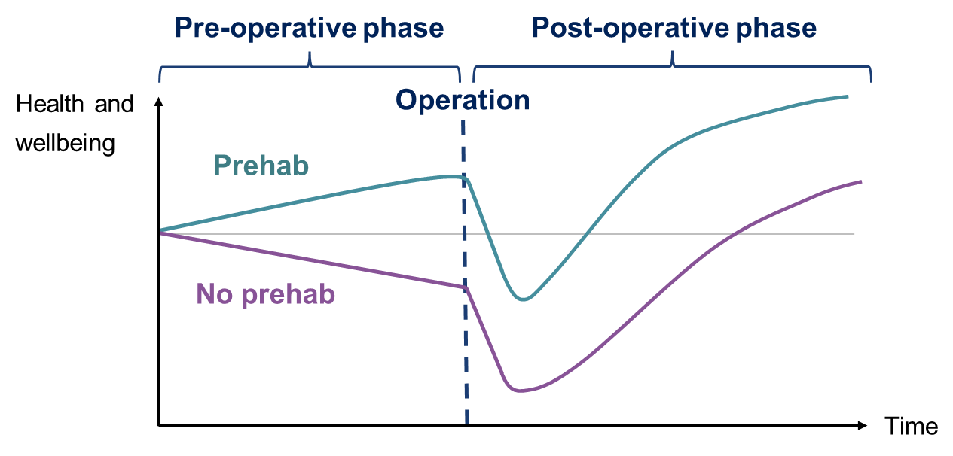
>97,600
total knee replacements (TKRs) recorded on the National Joint Registry in 2019 (NJR, 2021)
23% of patients awaiting TKR report a health state ‘worse than death’ (Clement et al. 2021)

Slide 6
>97,600
total knee replacements (TKRs) recorded on the National Joint Registry in 2019 (NJR, 2021)
23% of patients awaiting TKR report a health state ‘worse than death’ (Clement et al. 2021)
No support
Knee schools
Digital tools
Booklets
1:1 sessions
Telephone

Slide 7
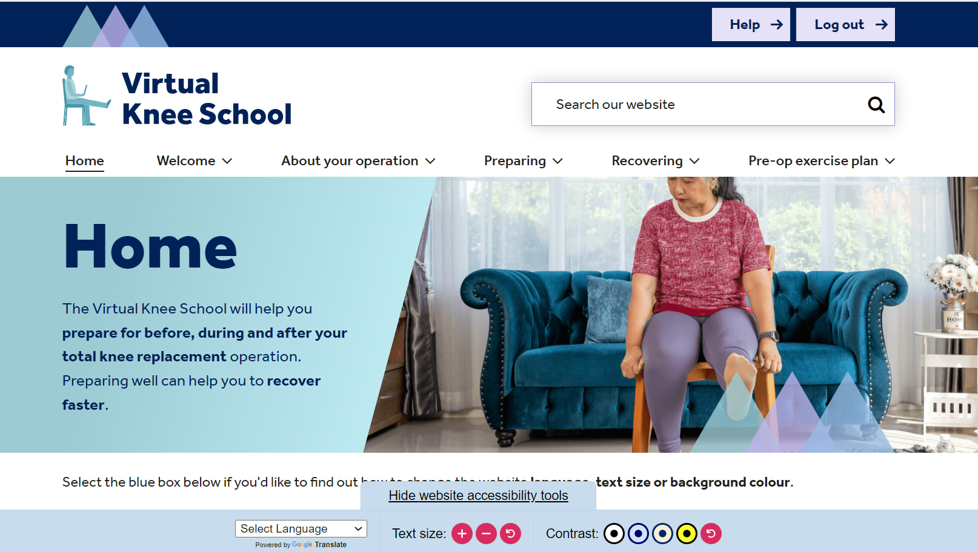

Slide 8
Project overview
Mixed methods rapid
review
Qualitative descriptive study
Prototype development, iterative refinement
Future
research
Modified Delphi study
Theoretical modelling
Patient and Public Involvement

Slide 9
Reviewing previous research: mixed methods rapid review
3,263 articles screened
185 full articles reviewed
52 studies included
Intervention type | Outcomes studies | Views studies
Education | 5 | 20
Exercise | 20 | 3
Psychological | 2 | 1
Lifestyle | 1 | 4
Other | 5 | 1
Definitive evidence to guide the design of pre-operative TKR interventions is lacking.
Employing more than one delivery format and personal tailoring appear to be valuable.

Slide 10
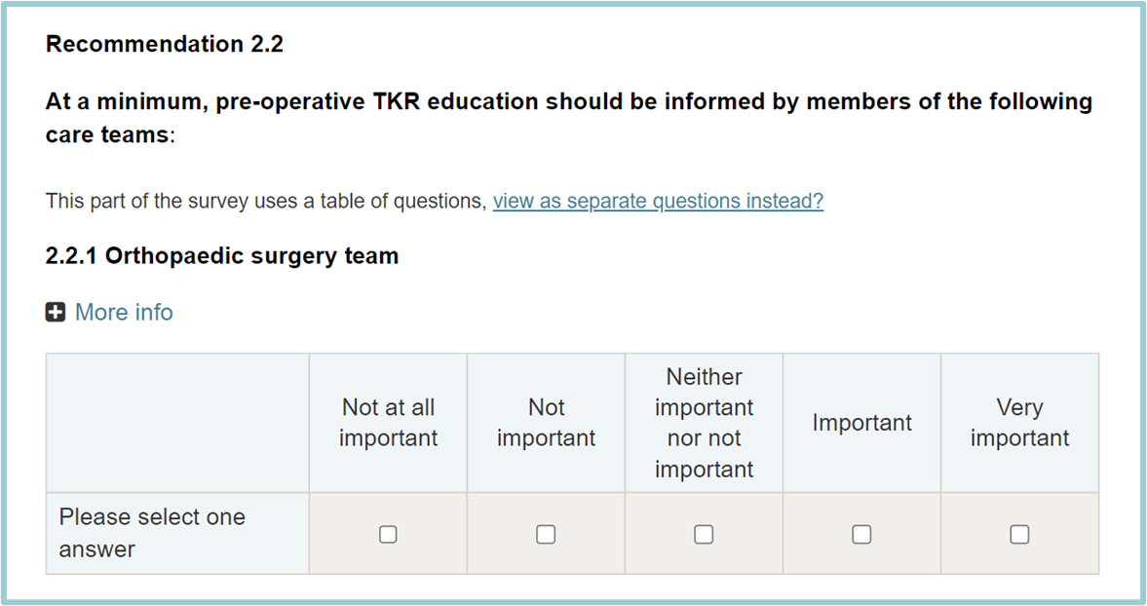
Developing recommendations: modified Delphi study
Purposes of the recommendations
To help inform health professionals’ decision-making on pre-operative TKR care provision.
To help us decide what to include in the Virtual Knee School.
Round 1
60 panellists
Round 2
57 panellists
Round 3
55 panellists

Slide 11
Final recommendations
Recommendation section | Recommendation items
Education topics | 34
Education delivery | 18
Exercise types | 10
Exercise delivery | 13
Other treatments | 2
Total | 77
Comprehensive pre-operative support is valued.
Physiotherapy teams could address most recommendations.
Collaborative working with / signposting to community partners could help address all the recommendations.

Slide 12
Exploring patients’ views: qualitative descriptive study
Focus groups with 14 patients who were awaiting and/or had undergone TKR
Physical / psychological factors
Digital tools
Theme 1
Accounting for individual differences
Theme 2
Tailoring to the pre-operative context
Pre-operative education
Social / work-related factors
Limitations in pre-operative TKR care
Prehabilitation

Slide 13
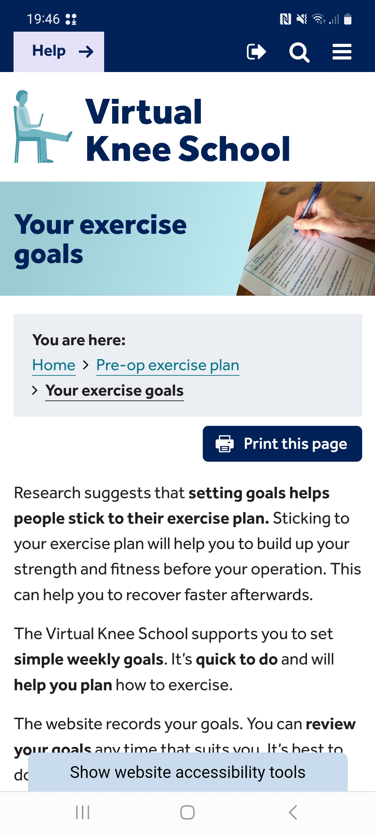
Barriers and facilitators tables
Barrier | Facilitator | Design feature
Fear of damaging knee | N/A | Reassurance
N/A | Tracking exercises | Online exercise diary, printable exercise diary
Setting goals and not meeting them | Setting and reviewing goals and receiving feedback | Optional goal-setting feature, printable goal-setting sheet, guidance on setting realistic goals

Slide 14
Drawing on / developing theory: theoretical modelling
Guiding principles
Six principles to guide the intervention development
Behavioural analysis
Detailed lists of possible intervention features
Findings from PPI discussions and the previous intervention planning phases
Logic model
Diagram showing how we think the intervention will work

Slide 15
Developing the Virtual Knee School prototype
Identifying and prioritising intervention features
Developing the prototype content
Designing, building and testing the prototype

Slide 16
Developing the Virtual Knee School prototype
Identifying and prioritising intervention features
Developing the prototype content
Designing, building and testing the prototype

Slide 17
Developing the Virtual Knee School prototype
Identifying and prioritising intervention features
Developing the prototype content
Designing, building and testing the prototype

Slide 18
Developing the Virtual Knee School prototype
Identifying and prioritising intervention features
Developing the prototype content
Designing, building and testing the prototype

Slide 19
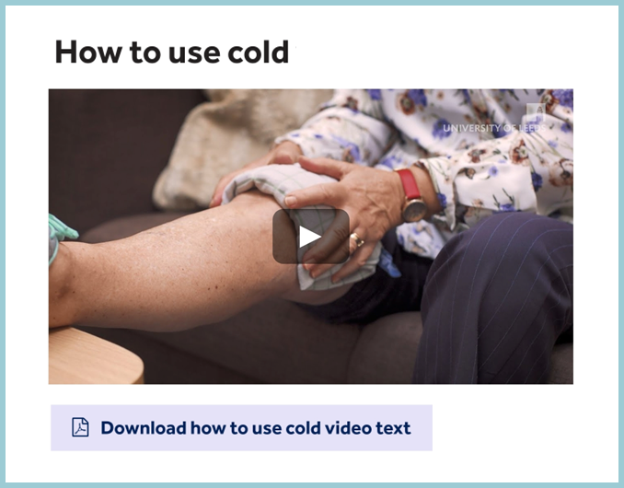
Developing the Virtual Knee School prototype
Identifying and prioritising intervention features
Developing the prototype content
Designing, building and testing the prototype

Slide 20
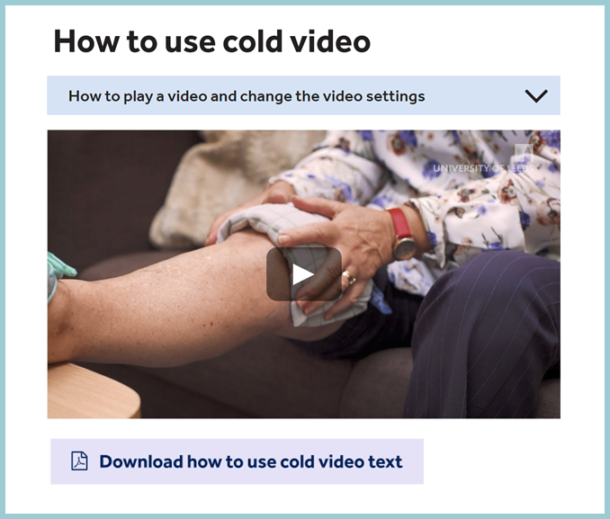
Developing the Virtual Knee School prototype
Identifying and prioritising intervention features
Developing the prototype content
Designing, building and testing the prototype

Slide 21
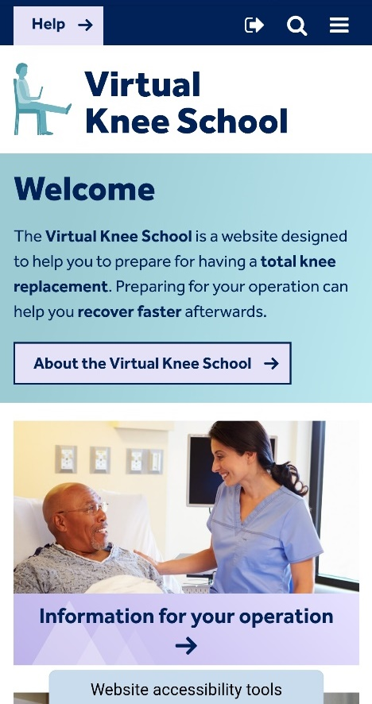
Refining the Virtual Knee School prototype: think-aloud study
Think-aloud interviews with nine patients who were awaiting and/or had undergone total knee replacement

Slide 22
Refining the Virtual Knee School prototype: think-aloud study
“I keep coming back
to the fact that you’re selling
it as a pre-operation thing and yet you’ve got information on what you do afterwards.
I find that a little bit contradictory.”
Glen (male, 70-79 years, confident in using the Internet)

Slide 23
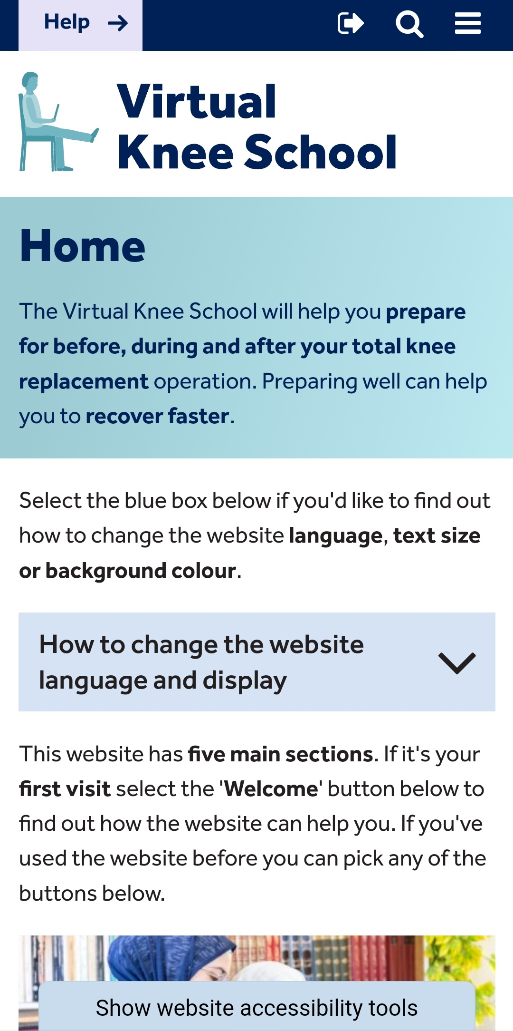
Refining the Virtual Knee School prototype: think-aloud study
“I keep coming back
to the fact that you’re selling
it as a pre-operation thing and yet you’ve got information on what you do afterwards.
I find that a little bit contradictory.”
Glen (male, 70-79 years, confident in using the Internet)

Slide 24
Patients’ overall views of the Virtual Knee School
“[…] but it’s just a bit, making me feel like, ooh, blooming heck, more load of rubbish, you know, I don’t need all this.”
“I liked the website, how
it was organised. And it was very visual. Then if you’re not very computer literate it’s very practical.”
“[...] to me a
website is alright if you can use these, but if you can’t use them, it’s just not
helpful at all.”
Laurence (male, 60-69 years, confident in using the Internet)
Jessica (female, 50-59 years, neither confident nor unconfident in using the Internet)
Vera (female, 70-79 years, unconfident in using the Internet)

Slide 25
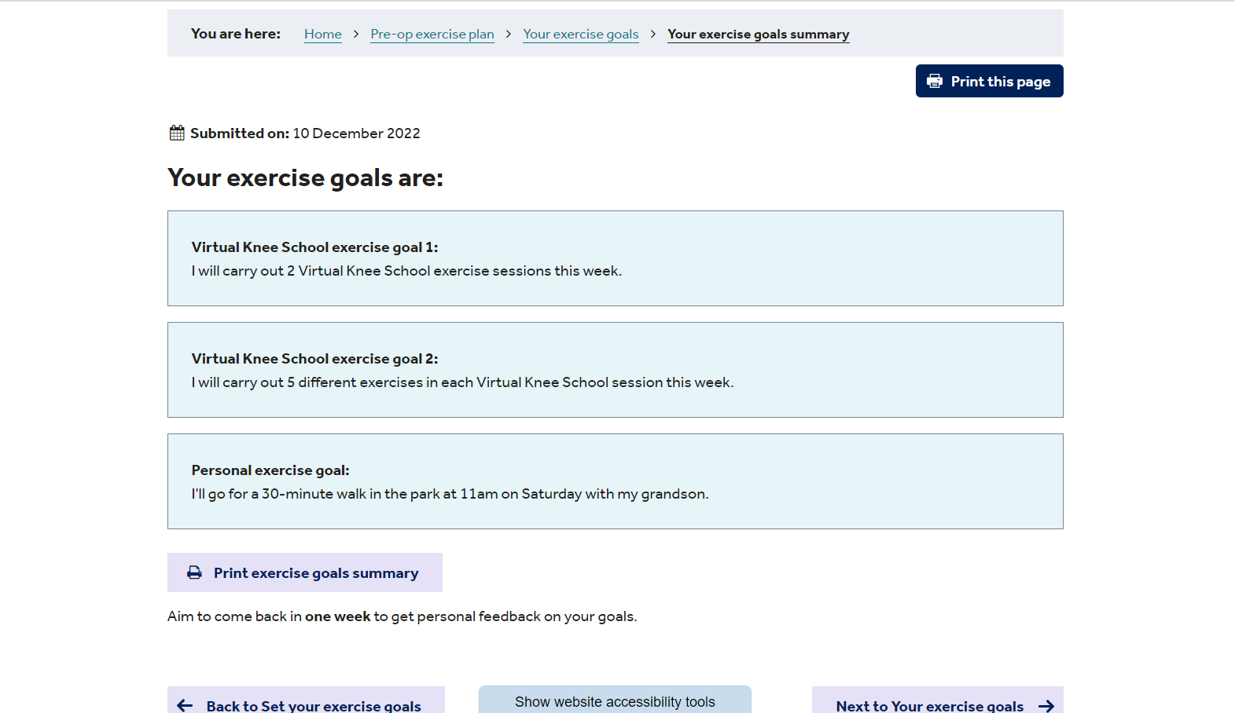
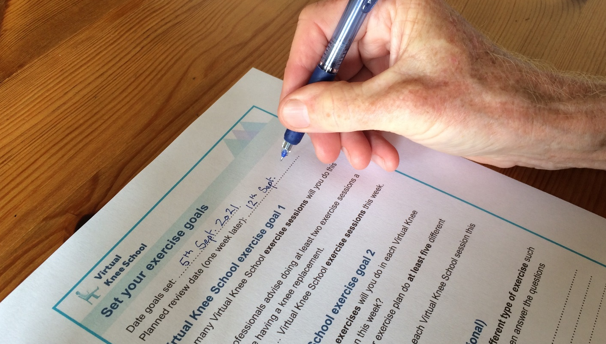
Developing meta-inferences
Meta-inference 1
Comprehensive pre-op TKR education and prehabilitation support should be rapidly accessible in digital and non-digital formats

Slide 26
Developing meta-inferences
Meta-inference 1
Comprehensive pre-op TKR education and prehabilitation support should be rapidly accessible in digital and non-digital formats
Meta-inference 2
Pre-op TKR digital tools should employ computer- and self-tailoring to account for patients’ individual needs and preferences

Slide 27
Developing meta-inferences
Meta-inference 1
Comprehensive pre-op TKR education and prehabilitation support should be rapidly accessible in digital and non-digital formats
Meta-inference 2
Pre-op TKR digital tools should employ computer- and self-tailoring to account for patients’ individual needs and preferences

Slide 28
Key lessons learned
Provide comprehensive pre-operative TKR education and prehabilitation support.
Provide and encourage use of digital tools but also offer alternatives.
Prioritise equity, diversity and inclusion when developing new tools and services.

Slide 29
Acknowledgements and references
Project Advisory Group members; Patient and Public Involvement representatives; Participants
Supervisors: Professor Anthony Redmond, Professor Gretl McHugh, Dr Christine Comer, Professor Lucy Yardley
Advisors: Professor Toby Smith, Professor Hemant Pandit, Dr Deborah Antcliff, Dr Judith Joseph, Dr Benjamin Drew
People and organisations who helped with recruitment, including the ATOCP!
Sponsor: University of Leeds; Web development company: Frank
Funder: Health Education England (HEE) / National Institute of Health and Care Research (NIHR) (Clinical Doctoral Research Fellowship, ICA-CDRF-2018-04-ST2-006)
All images subject to copyright.
Clement ND et al. The number of patients “worse than death” while waiting for a hip or knee arthroplasty has nearly doubled during the COVID-19 pandemic. Bone Joint J. 2021;103-B(4):672-80.
National Joint Registry. NJR Reports: Types of primary knee replacements undertaken. 2021. https://reports.njrcentre.org.uk/knees-all-procedures-activity/. Accessed 09 Jun 2022

Slide 30
Virtual Knee School project references
Anderson AM et al. Consensus on pre-operative total knee replacement education and prehabilitation recommendations: a UK-based modified Delphi study. BMC Musculoskelet Disord. 2021;22(1):352. (Recommendations summary in Additional File 8).
Anderson AM et al. Content and delivery of pre-operative interventions for patients undergoing total knee replacement: a rapid review. Syst Rev. 2022;11(1):184.
Anderson AM. Development of a pre-operative education and prehabilitation digital intervention for patients awaiting total knee replacement: a Virtual Knee School. PhD thesis. University of Leeds; 2022. https://etheses.whiterose.ac.uk/31279/
Anderson AM et al. Supporting patients to prepare for total knee replacement: Evidence-, theory- and person-based development of a 'Virtual Knee School' digital intervention. Health Expect. 2023. doi: 10.1111/hex.13855. Epub ahead of print.
Email: A.Anderson@leeds.ac.uk | Twitter: @_Anna_Anderson
Anna Anderson, Clinical Doctoral Research Fellow, ICA-CDRF-2018-04-ST2-006, was funded by Health Education England (HEE) / NIHR for this research project. The views expressed in this presentation are those of the author(s) and not necessarily those of the NIHR, NHS or the UK Department of Health and Social Care.

