Slide 1
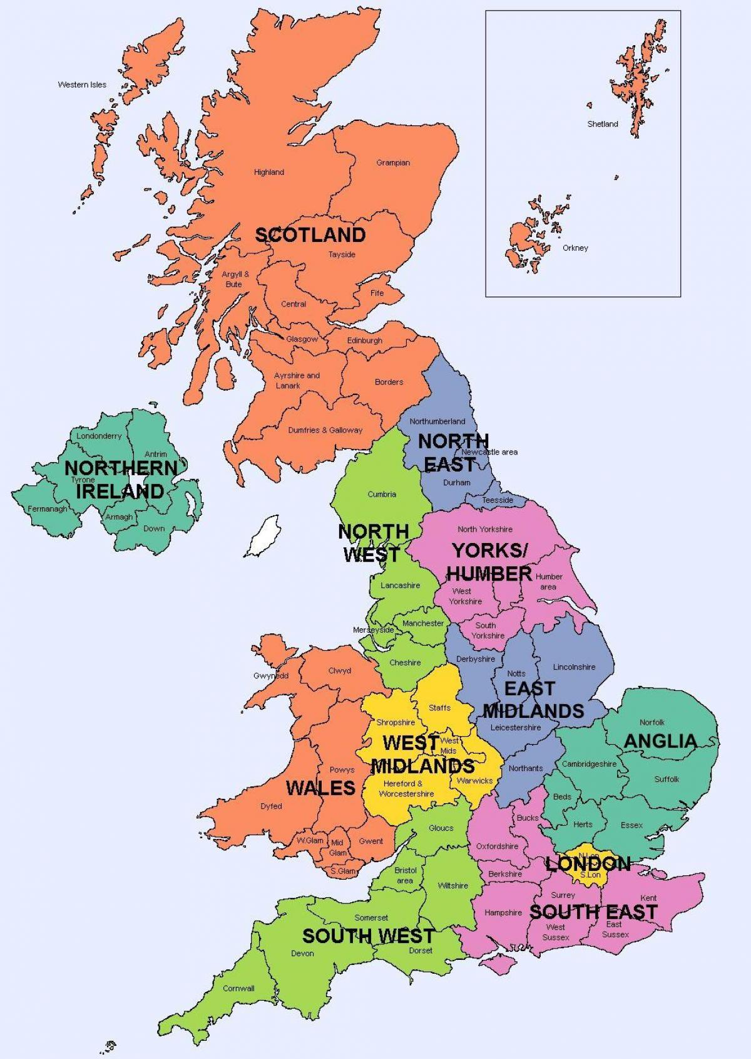
Summary of Local Branches Chair and Contact details
Region | Chairs | Email | Twitter
London | Abby Newdick | atocplondon@gmail.com | (5) ATOCP London (@ATOCP_London) / Twitter
North East | TBC | northeast@atocp.org | @atocp_northeast
North West | Julie Blackburn | Jools1k@aol.com | @atocpNorthwest
Oxford | Jon Room | oxfordatocp@gmail.com | @ATOCP_Oxford
Peninsula | Rebecca Fox | peninsulaatocp@gmail.com
Edinburgh | Mary O’Riordan | ATOCPEdinburgh@hotmail.com | @ATOCP_Edinburgh
South Central | Rachel Martin | atocpsouth@gmail.com | @ATOCPSouth/ ATOCP South Branch | Facebook
South East | Jayanti Rai | SoutheastATOCP@gmail.com
South Wales | Georgina Hooper |  | @ATOCP_SWALES
South West – Severn | Jocelyn Hopkins & Sarah Marshall | atocp.sw.severn@gmail.com | @ATOCP_SW_Severn
West Midlands | Caroline Miller & Andy Green | ATOCPwestmids@gmail.com | @ATOCP_WestMids
Correct at time of publishing 2023

